Slide 1


Campaign Compass
Revolutionizing Elections in the digital Age!

Slide 2


OBJECTIVE
The objective of this project is to develop a comprehensive and efficient Political Campaign Management Software tailored to the needs of political candidates, campaign managers, volunteers, donors, and other stakeholders involved in the electoral process. The software aims to streamline the management and execution of political campaigns by providing robust tools and features for planning, organizing, and monitoring campaign activities.

Slide 3

OUR
VISION
Our vision is to provide candidates with equitable opportunities and resources to participate in the electoral process. By leveraging digital platform, we aim to democratize access to all backgrounds to effectively engage with voters and compete on a level playing field.
The system empowering features for grassroots organizing and member engagement, we aim to decentralize decision-making, empower local communities, and foster a culture of participation and collaboration at all levels of the party.
Tools for internal democracy and accountability mechanisms, we aim to set a high standard for political integrity, earning the trust and confidence of our members, supporters, and the broader public.

Slide 4

MIND MAP

Slide 5
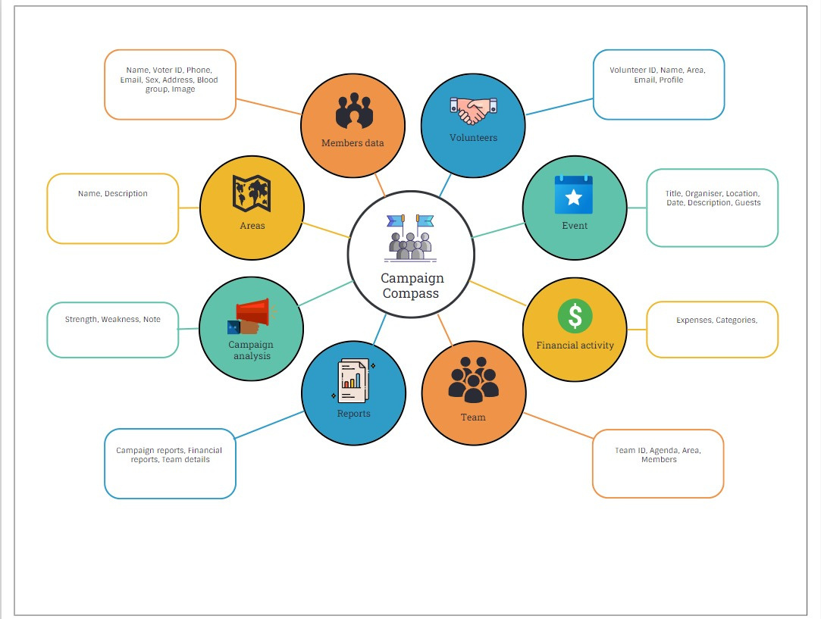

Slide 6
VISUAL REPRESENTATION
For the better understanding about the concept and ER diagram of Campaign compass, We prepared a 3 minutes Animated video
https://drive.google.com/file/d/1SxAZGVilQcgsJ3vTTmFVQ9h9sEjGdc3f/view?usp=sharing

Slide 7



ER - DIAGRAM
An Entity-Relationship (ER) diagram is a visual representation used to model the structure of a database. It's a powerful tool for designing databases as it provides a clear depiction of the entities within the system and the relationships between them.

Slide 8
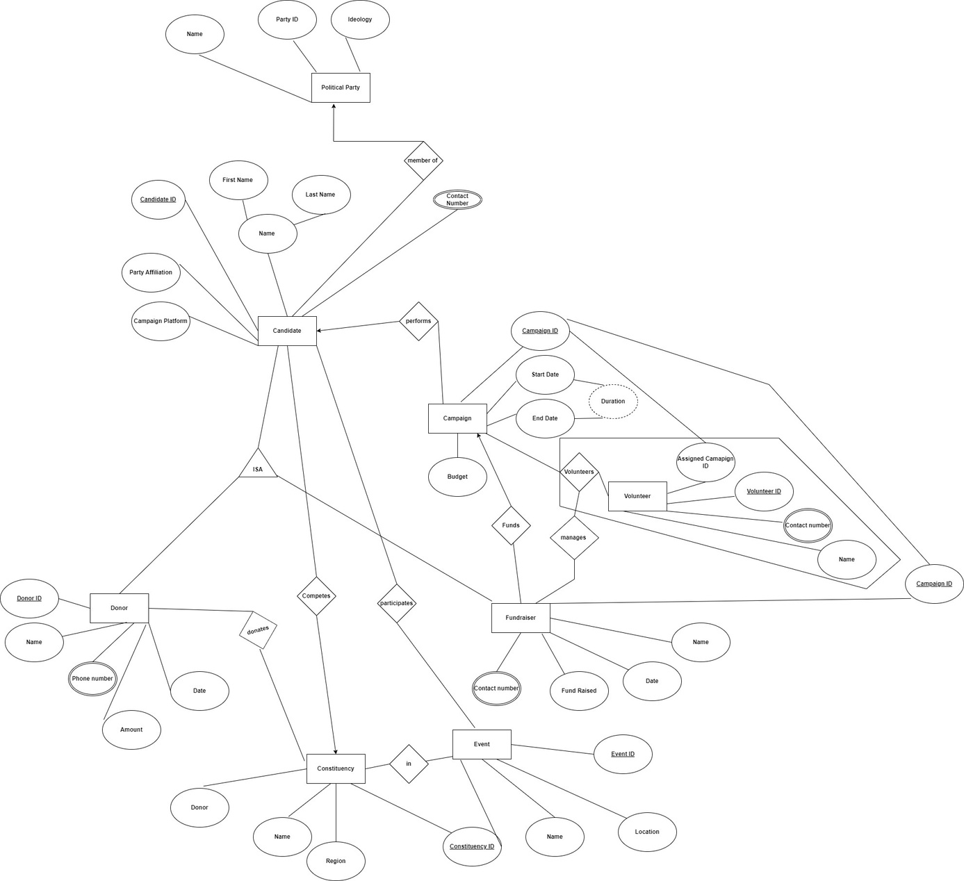

Slide 9
